Slide 1
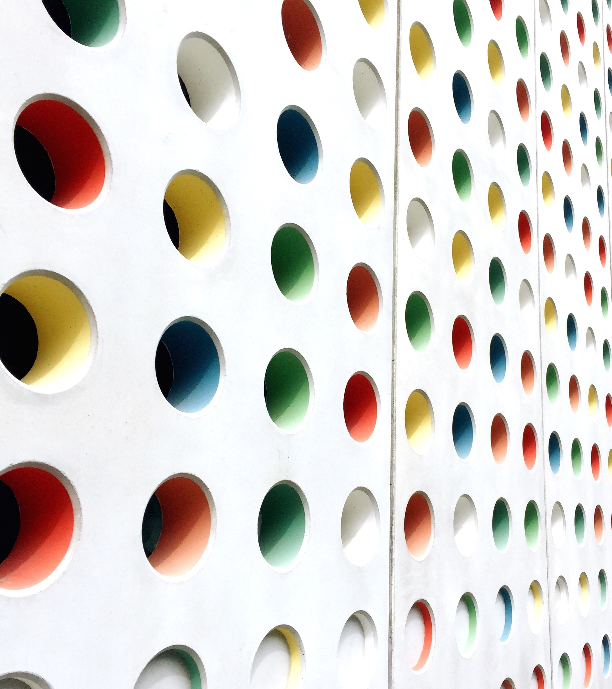
Overview of SLAM
Sit Dolor Amet

Slide 2
SLAM
SLAM stands for Simultaneous Localization and Mapping.
It is a technique used in robotics to solve the problem of building a map of an unknown environment while simultaneously localizing the robot within that map.
The main goal of SLAM is for a robot to navigate and explore an unknown environment, create a map of that environment, and at the same time, determine its own position within that map. This is done in real-time, without any prior knowledge of the environment.

Slide 3
SLAM
SLAM is a fundamental problem in robotics because it enables robots to operate autonomously in unknown or dynamic environments.
By using SLAM, robots can navigate, explore, and perform tasks in environments where pre-built maps are not available or may be outdated.

Slide 4
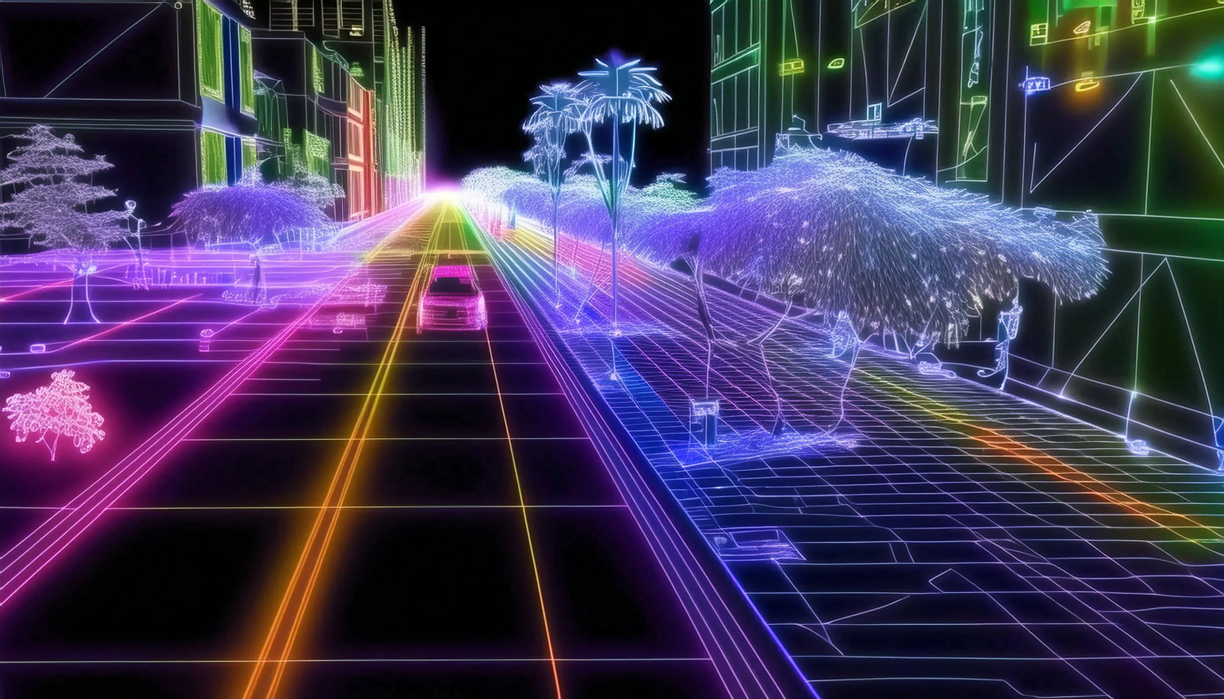
SLAM can be used to create a map of the world

Slide 5
SLAM APPLICATIONS
autonomous vehicles, drones, mobile robots, and even augmented reality systems.
For example, in autonomous vehicles, SLAM allows the vehicle to navigate and build a map of its surroundings, enabling it to plan safe and efficient paths.
In drones, SLAM helps in mapping the environment and maintaining stable flight.
In augmented reality systems, SLAM is used to overlay virtual objects onto the real world accurately.

Slide 6
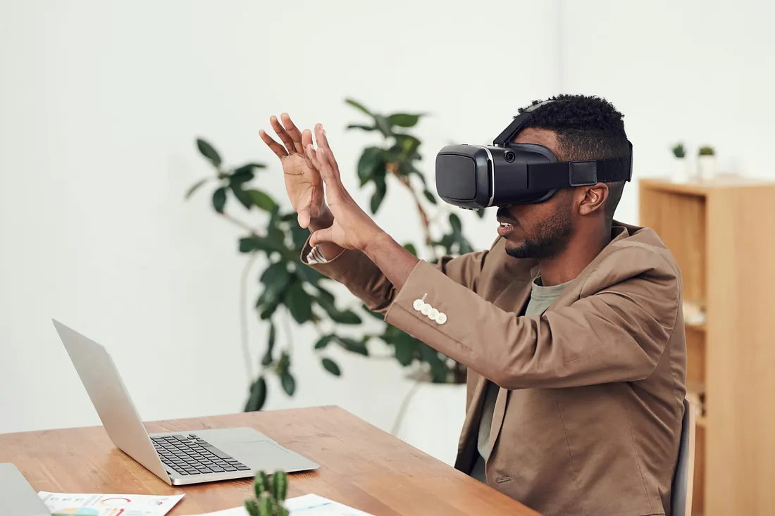
SLAM can also be used for Augmented Reality

Slide 7
SLAM
To achieve SLAM, robots typically use a combination of sensor data, such as cameras, lidars, or range finders, to perceive the environment.
They also utilize algorithms that process this sensor data, estimate the robot’s position, and update the map as the robot moves.

Slide 8
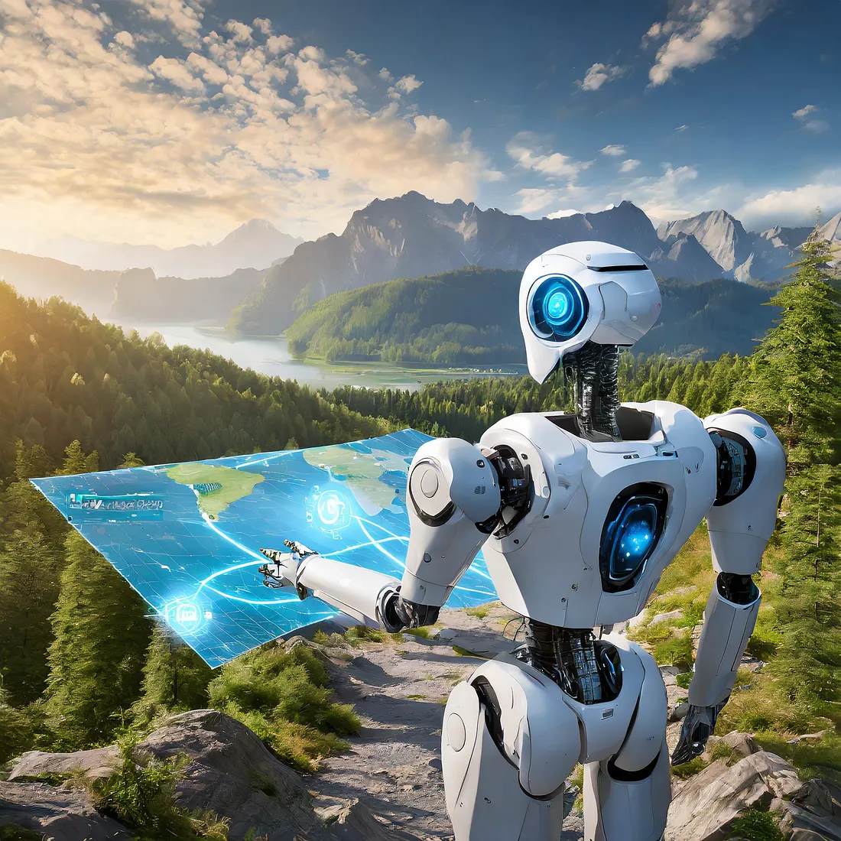
A robot uses its sensors to detect its surrounding landmarks. It’s able to create a map based on its sensor measurements, and it’s also able to identify its location on the map.

Slide 9
Necessary vocabulary to understand SLAM
Loop Closure
Localization
Mapping
Robots
Landmarks
Sensors
Odometry

Slide 10
Localization
Localization refers to the estimated poses of the robot.
It contains the robot’s position and orientation at different time steps.
These poses are typically represented as (x, y, theta) coordinates, where (x, y) represents the position and theta represents the orientation.

Slide 11
Mapping
Mapping refers to the estimated positions of the landmarks in the environment.
Landmarks are distinct features in the environment that the robot can perceive, such as walls, corners, or objects.

Slide 12
Robots
Robots are the autonomous agents that are equipped with sensors and actuators to interact with the environment.
In the context of SLAM, the robot’s main task is to explore the environment, collect sensor data, and estimate its own position and the positions of landmarks.
In the context of augmented reality (AR) systems on smartphones, there is typically no physical robot involved; instead, the smartphone itself can be considered as the “robot”.

Slide 13
Landmarks
Landmarks are distinct features or points of interest in the environment that the robot can perceive.
They can be objects, corners, walls, or any other feature that the robot can use to navigate and localize itself. Landmarks serve as reference points for the robot’s position estimation.

Slide 14
Sensors
Sensors are the devices that the robot uses to perceive the environment.
They provide information about the robot’s surroundings, such as range measurements, images, or depth data.
Common sensors used in SLAM include range finders (such as laser range finders or ultrasonic sensors), cameras, lidars, and odometry sensors.
In the context of a smartphone as a “robot”, the smartphone acts as a platform that integrates various sensors, such as cameras, gyroscopes, accelerometers, and depth sensors, to perceive the real-world environment.

Slide 15
Odometry
Odometry refers to the estimation of the robot’s motion based on its internal sensors, such as wheel encoders, accelerometers, or gyroscopes.
It provides information about the robot’s velocity, rotation, and displacement.

Slide 16
Loop Closure
Loop closure is the process of detecting and correcting loops in the robot’s trajectory.
It occurs when the robot revisits a previously observed landmark or location.
Loop closure is important for correcting accumulated errors and improving the accuracy of the SLAM solution.

Slide 17
Use cases for SLAM
SLAM technology is becoming increasingly prevalent in our daily lives,
even though we may not always be aware of it.
few examples of SLAM applications that we encounter in our daily lives:

Slide 18
GPS Navigation Systems
Many outdoor GPS navigation systems utilize SLAM techniques to provide accurate and real-time positioning information.
These systems combine GPS data with other sensor inputs, such as accelerometers and gyroscopes, to estimate the vehicle’s position and orientation.
Examples include Google Maps, Waze, and Apple Maps.

Slide 19
Mobile Augmented Reality (AR) Apps
AR apps on smartphones and tablets often employ SLAM algorithms to track the device’s position and overlay virtual objects onto the real world.
SLAM helps to precisely align virtual content with the user’s surroundings, creating immersive AR experiences.
Examples include Pokémon Go, SnapChat, and Instagram.

Slide 20
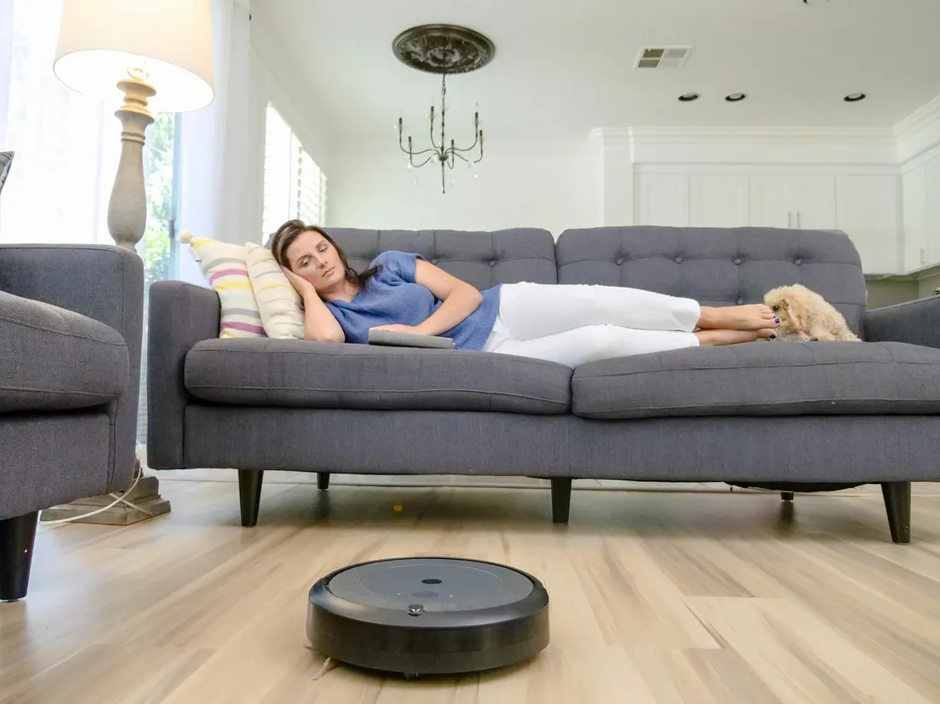
Autonomous Vacuum Cleaners
Robotic vacuum cleaners, such as Roomba, utilize SLAM to navigate and clean a room efficiently.
They build a map of the environment and use localization techniques to determine their position within that map
Enabling them to autonomously navigate and avoid obstacles.

Slide 21
Indoor Navigation Systems
SLAM is used in indoor navigation systems to provide real-time location information within large buildings like shopping malls, airports, or museums.
By using sensors like cameras or depth sensors, SLAM algorithms can map the indoor environment and assist users in navigating through complex spaces.
One example of SLAM-based indoor navigation is Google’s “Indoor Maps” feature, which is available in their Google Maps application.
It uses SLAM alongside Wi-Fi, Bluetooth, and other sensor data to provide real-time location information and directions within these buildings.

Slide 22
Self-driving Cars
SLAM is a fundamental technology for autonomous vehicles.
Self-driving cars use various sensors, such as LiDAR, cameras, and radar, to perceive their surroundings and build a detailed map of the environment.
SLAM algorithms help the vehicle localize itself within the map and navigate safely.
Examples include Waymo, Tesla, Cruise, and Uber.

Slide 23
Build and Deploy Simultaneous Localization and Mapping (SLAM) Workflows with MATLAB

